Slide 1
Electric Circuits Discussion 2
TA: Kefei Wu, Ke Zhang
Spring 2018

Slide 2
Outline
Homework 2
Review
Op Amplifier
Ideal op amplifier
Extension

Slide 3
Homework 2

Slide 4
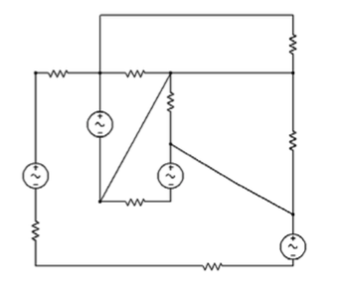

Slide 5
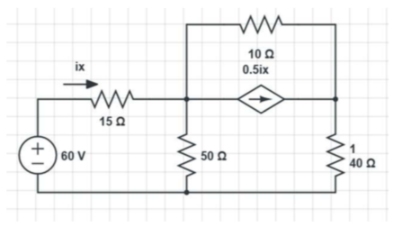

Slide 6
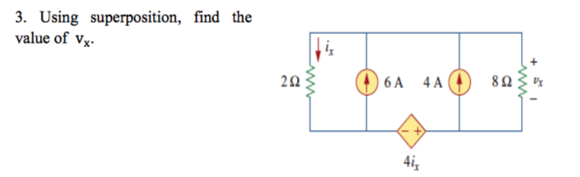

Slide 7
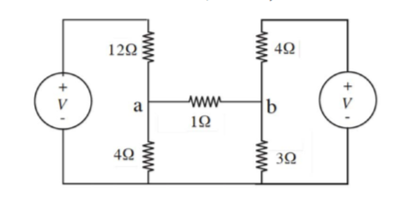

Slide 8
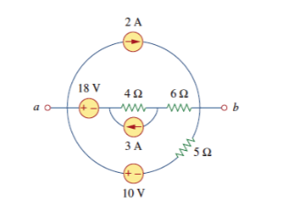
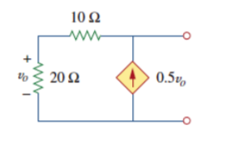

Slide 9
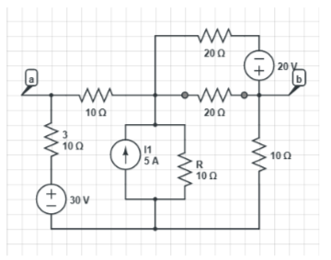

Slide 10
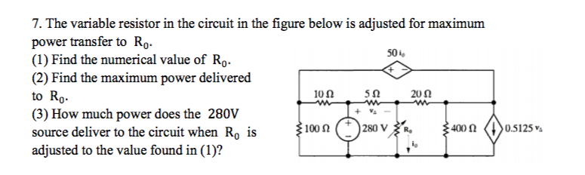

Slide 11
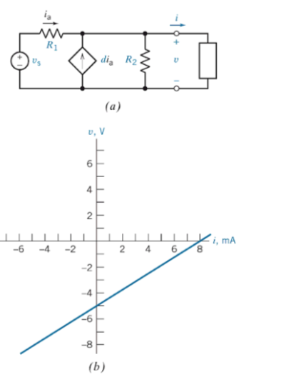

Slide 12
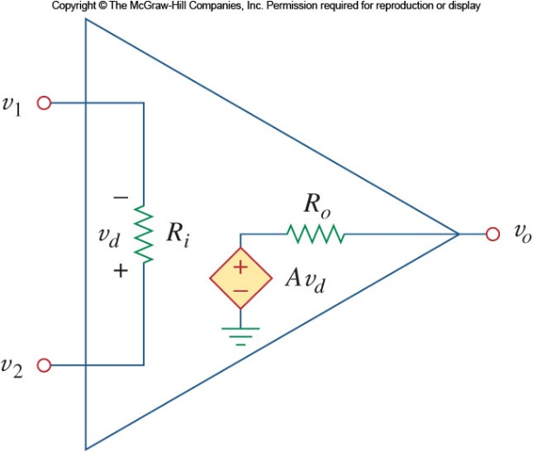
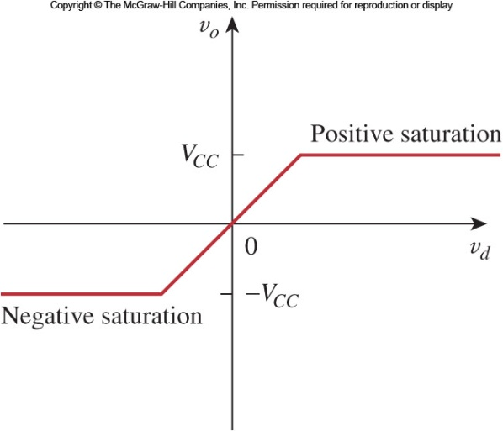
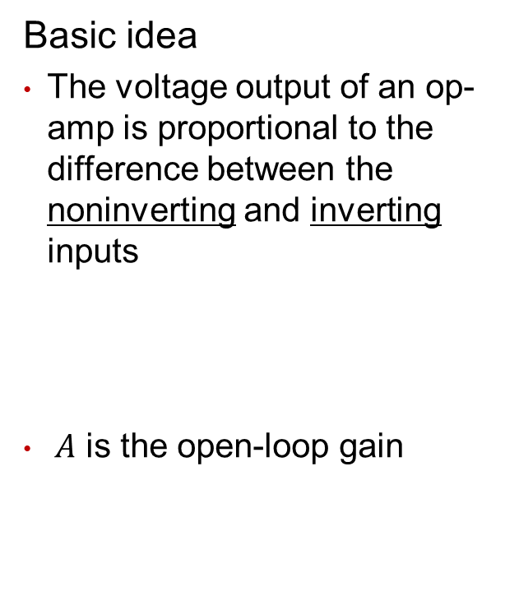
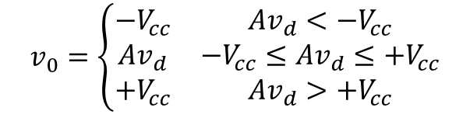
Op Amplifier
Basic idea
The voltage output of an op-amp is proportional to the difference between the noninverting and inverting inputs
$A$ is the open-loop gain
$$v_{0}=\left\{\begin{matrix}−V_{cc} & Av_{d}<−V_{cc} \\ Av_{d} & −V_{cc}≤Av_{d}≤{+V}_{cc} \\ +V_{cc} & Av_{d}>{+V}_{cc}\end{matrix}\right.$$

Slide 13
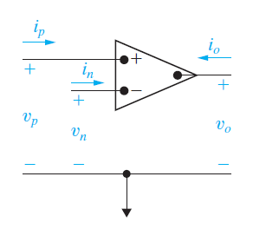
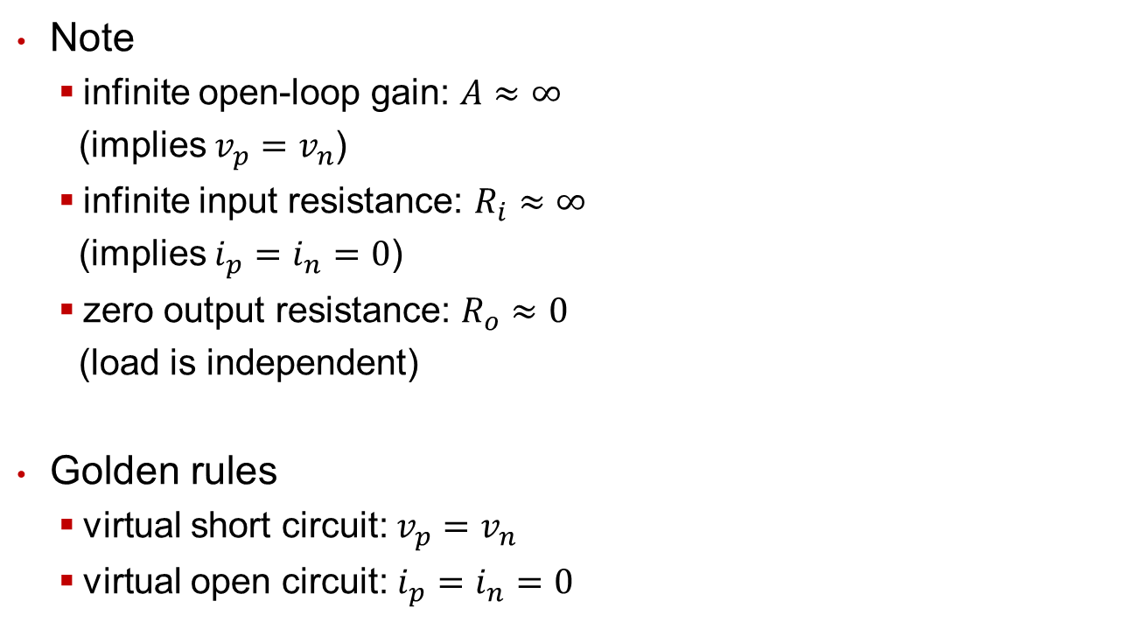
Ideal Op-Amp Analysis
Note
infinite open-loop gain: $A≈∞$
(implies $v_{p}=v_{n}$)
infinite input resistance: $R_{i}≈∞$
(implies $i_{p}=i_{n}=0$)
zero output resistance: $R_{o}≈0$
(load is independent)
Golden rules
virtual short circuit: $v_{p}=v_{n}$
virtual open circuit: $i_{p}=i_{n}=0$

Slide 14
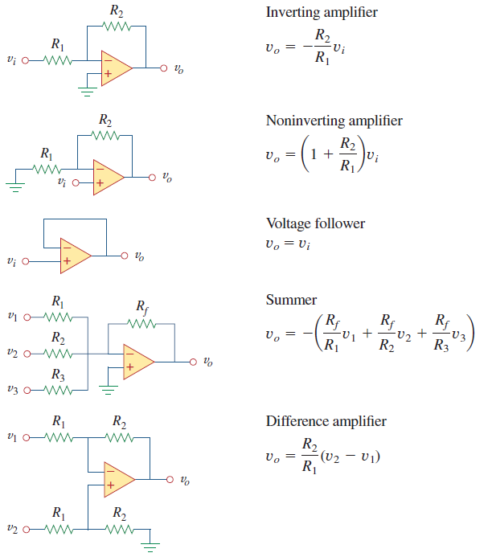
Ideal Op-Amp we have learned
to distinguish with where input signal is
the output is the weighted sum of the inputs
amplifies the difference between its input signals, output is proportional to the difference of two inputs

Slide 15
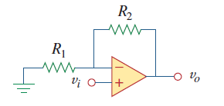
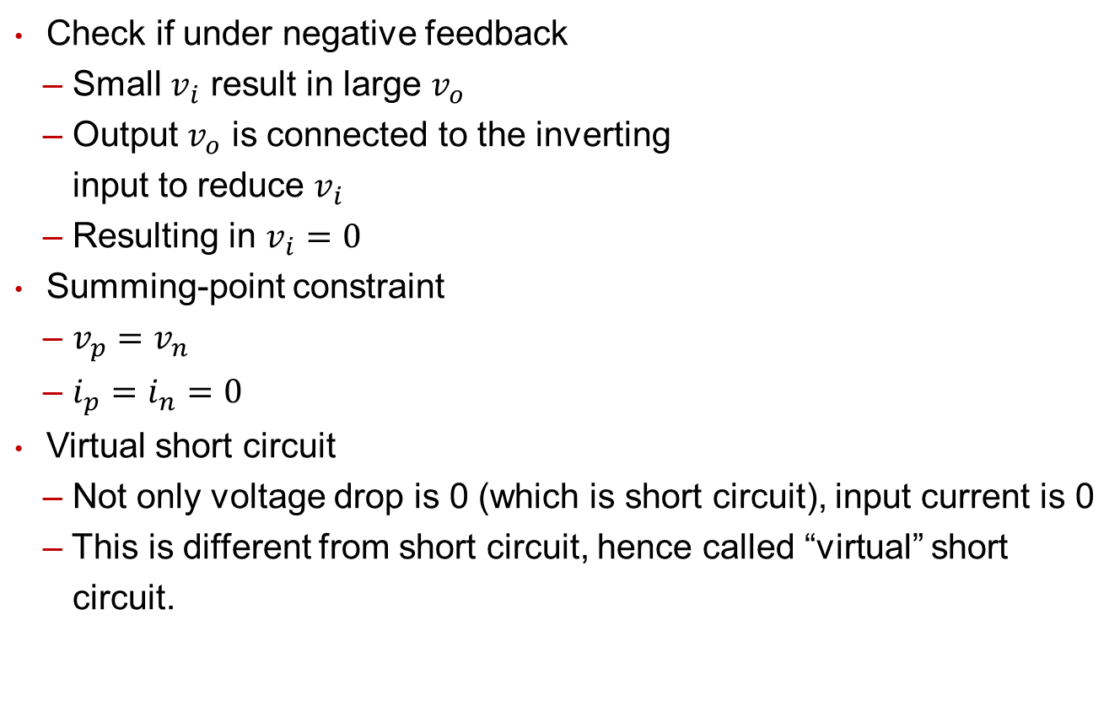
Summary
Check if under negative feedback
– Small $v_{i}$ result in large $v_{o}$
– Output $v_{o}$ is connected to the inverting
input to reduce $v_{i}$
– Resulting in $v_{i}=0$
Summing-point constraint
– $v_{p}=v_{n}$
– $i_{p}=i_{n}=0$
Virtual short circuit
– Not only voltage drop is 0 (which is short circuit), input current is 0
– This is different from short circuit, hence called “virtual” short
circuit.
Summing Point

Slide 16
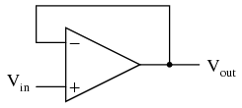
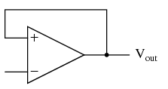

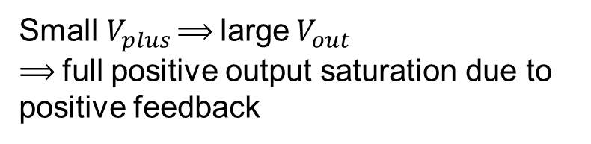
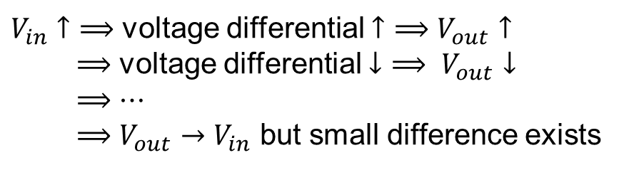
Extension 1: Positive feedback
Negative feedback
$V_{in}$ $↑$ $⟹$ voltage differential $↑$ $⟹$ $V_{out}$ $↑$
$⟹$ voltage differential $↓$ $⟹ V_{out}↓$
$⟹$ $⋯$
$⟹$ $V_{out}→V_{in}$ but small difference exists
giving the op-amp the capacity to work in its linear (active) mode.
Positive feedback
Small${ V}_{plus}$ ⟹ large${ V}_{out}$
⟹ full positive output saturation due to positive feedback
$${ V}_{plus}$$
making output larger when input increases, tends to cause system instability
Notes:
为保证稳定性，电路中基本都使用的是负反馈

Slide 17
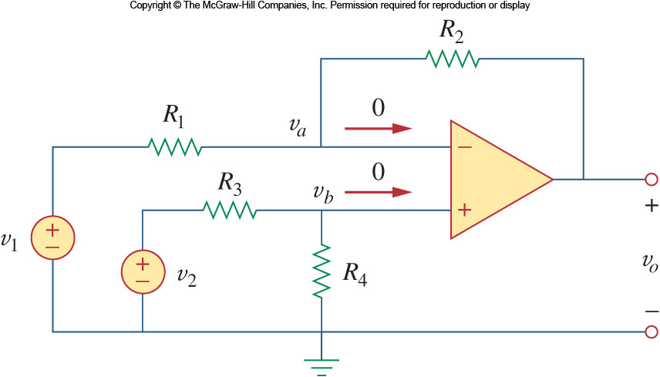
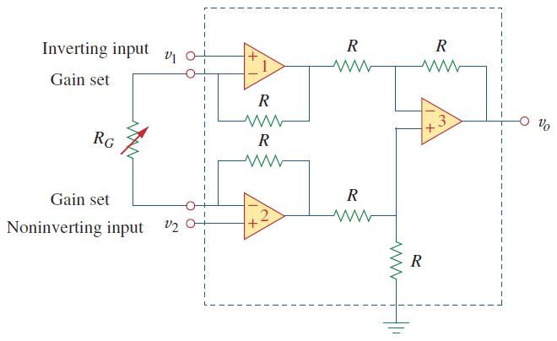


Extension 2: Instrumentation amplifier
IA: an extension of the difference amplifier. Recall its derivation.
$$v_{o}={A(v}_{o2}−v_{o1})$$
$$A=1+\frac{2R}{R_{G}}$$

Slide 18


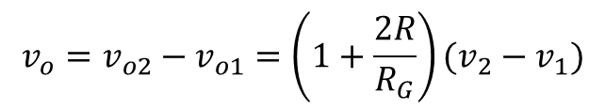
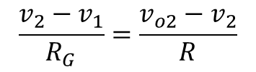
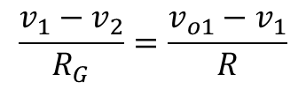
Extension 2: Instrumentation amplifier
$$\frac{v_{1}−v_{2}}{R_{G}}=\frac{v_{o1}−v_{1}}{R}$$
$$v_{o1}$$
$$\frac{v_{2}−v_{1}}{R_{G}}=\frac{v_{o2}−v_{2}}{R}$$
$$v_{o2}$$
$$v_{o}=v_{o2}−v_{o1}=\left(1+\frac{2R}{R_{G}}\right)(v_{2}−v_{1})$$

Slide 19
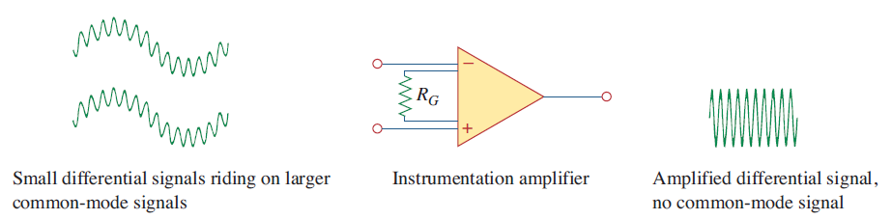
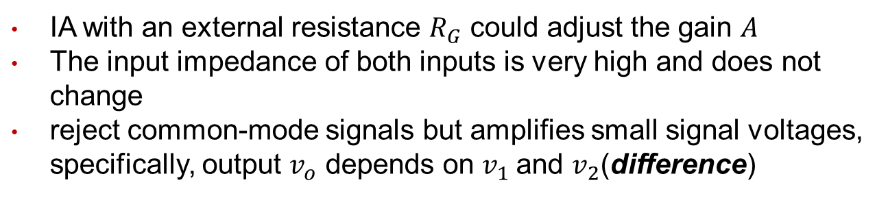
Extension 2: Instrumentation amplifier
major characteristics
simplified model
IA with an external resistance $R_{G}$ could adjust the gain $A$
The input impedance of both inputs is very high and does not change
reject common-mode signals but amplifies small signal voltages, specifically, output $v_{o}$ depends on $v_{1}$and $v_{2}$(difference)

Slide 20
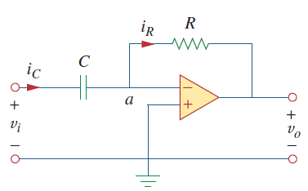
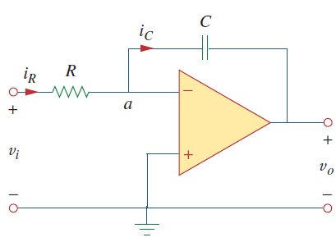




Extension 3: Differentiator & Integrator
Differentiator
Integrator

Slide 21
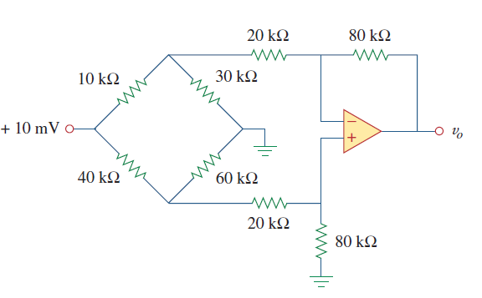

Exercise
Find $v_{o}$ in a differential amplifier driven by a bridge.

Slide 22








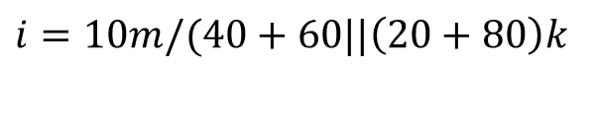

Exercise
$$v_{2}$$
$$i=10m/(40+60||\left(20+80\right)k$$
$$v_{1}=i×40+60||\left(20+80\right)k$$
$$i$$
$$v$$
$$v=0.8v_{1}$$
$$v_{1}$$
$$\frac{v_{2}−10m}{10k}+\frac{v_{2}}{30k}+\frac{v_{2}−v}{20k}=0$$
$$v_{o}=\frac{80}{20}(v_{1}−v_{2})$$
$$v_{o}=−6.69 mV$$

Slide 23
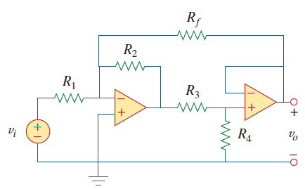
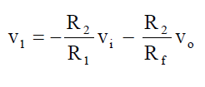
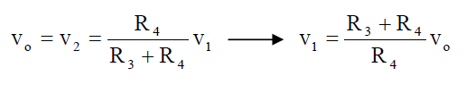
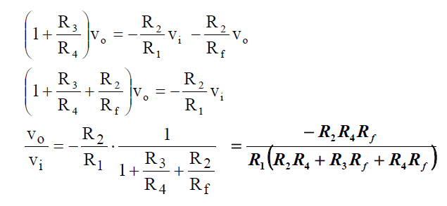



Exercise
Obtain the closed-loop voltage gain $v_{o}/v_{i}$ of the circuit
$$v_{2}$$
$$v_{1}$$

